Slide 1


3回目 テーマ模索
9LDI1101
徐 恃源

Slide 2


目次
論文紹介
Regular Expression
Tokenisation & Stopwords
Integer Encoding

Slide 3
Evebot: A Deep Learning Based Chatbot System for Campus Psychological Therapy
Guangdong Country Garden School 9 Oct 2019
In this paper, we propose Evebot, an innovative, sequence to sequence (Seq2seq) based, fully generative conversational system for the diagnosis of negative emotions and prevention of depression through positively suggestive responses. The system consists of an assemble of deeplearning based model, including Bi-LSTM based model for detecting negative emotion of users and obtaining psychological counselling related corpus for training the chatbot, anti-language sequence to sequence neural network, and maximum mutual information (MMI) model. As adolescents are reluctant to show their negative emotion in physical interaction, traditional method of emotion analysis and comforting methods may not work. Therefore, this system put emphasis on using virtual platform to detect signs of depression or anxiety, channel adolescents’ stress and mood, and thus prevent the emergence of mental illness. We launched the integrated chatbot system onto an online platform for real-world campus application. Through a one-month user study, we observe better results in the increase in positivity than other public chatbot in the control group.
Seq2seqを用いた次世代対話型システム
使用者の否定的な感情を感知し、ストレスや気分を図り伝達することで精神病を予防する。
Keywords: Chatbot, Conversational System, NLP, Psychological Therapy, Deep Learning

Slide 4
Empathetic Dialogue Generation via Sensitive Emotion Recognition and Sensible Knowledge Selection
Institute of Information Engineering School of Cyber Security, University Pattern Recognition Center WeChat AI 21 Oct 2022
Empathy, which is widely used in psychological counselling, is a key trait of everyday human conversations. Equipped with commonsense knowledge, current approaches to empathetic response generation focus on capturing implicit emotion within dialogue context, where the emotions are treated as a static variable throughout the conversations. However, emotions change dynamically between utterances, which makes previous works difficult to perceive the emotion flow and predict the correct emotion of the target response, leading to inappropriate response. Furthermore, simply importing commonsense knowledge without harmonization may trigger the conflicts between knowledge and emotion, which confuse the model to choose incorrect information to guide the generation process. To address the above problems, we propose a Serial Encoding and Emotion-Knowledge interaction (SEEK) method for empathetic dialogue generation. We use a fine-grained encoding strategy which is more sensitive to the emotion dynamics (emotion flow) in the conversations to predict the emotion-intent characteristic of response. Besides, we design a novel framework to model the interaction between knowledge and emotion to generate more sensible response. Extensive experiments on EMPATHETICDIALOGUES demonstrate that SEEK outperforms the strong baselines in both automatic and manual evaluations.
共感的会話生成のためのSerial Encoding and Emotion-Knowledge interaction (SEEK)。
知識と感情の間の相互作用をモデリング。
SEQが強い。

Slide 5
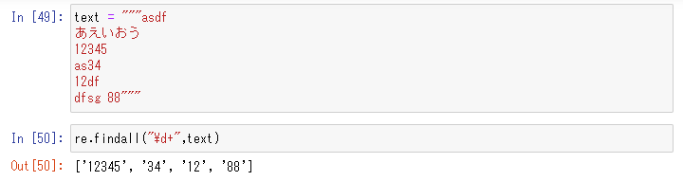
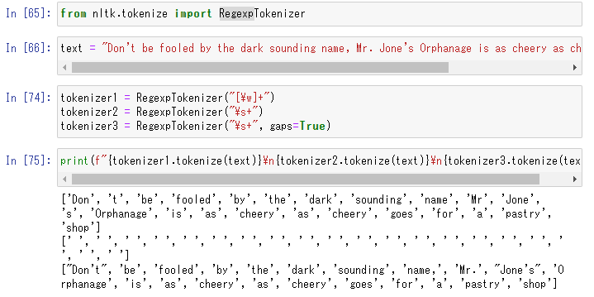
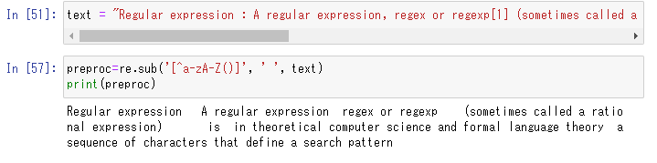
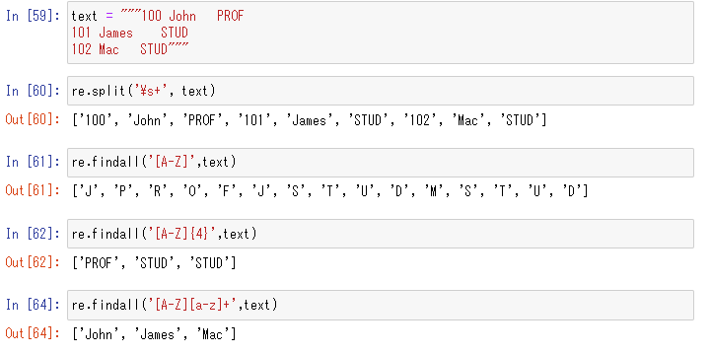
Regular Expression

Slide 6
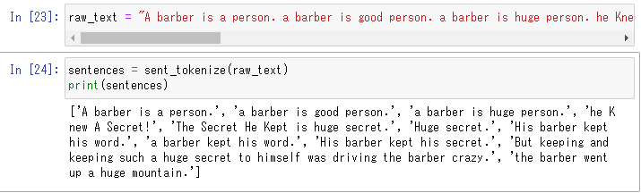
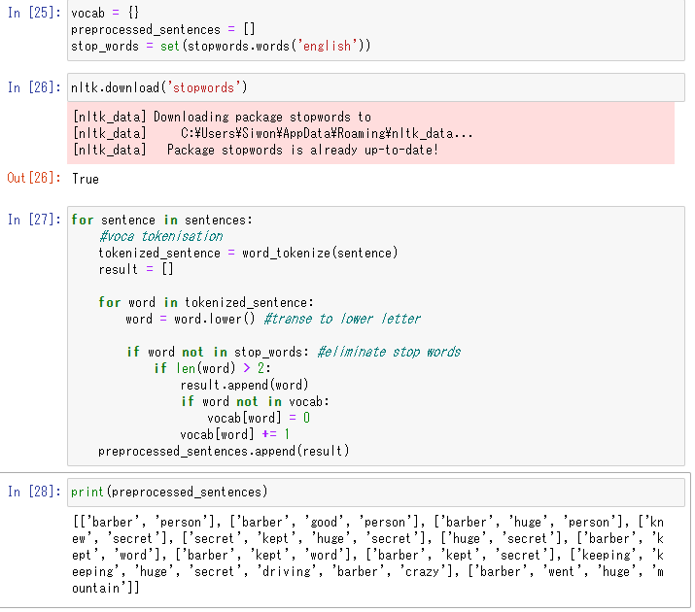
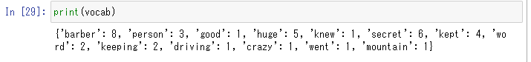
Tokenisation & Stopwords

Slide 7
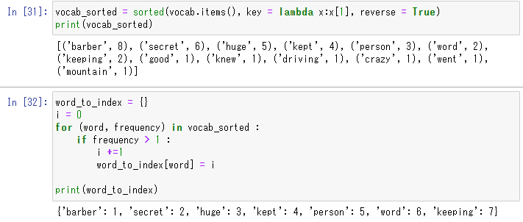
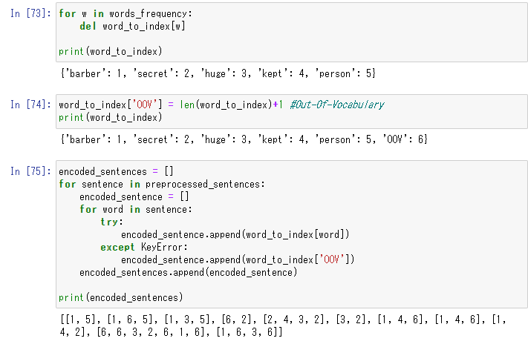
Integer Encoding

Slide 8
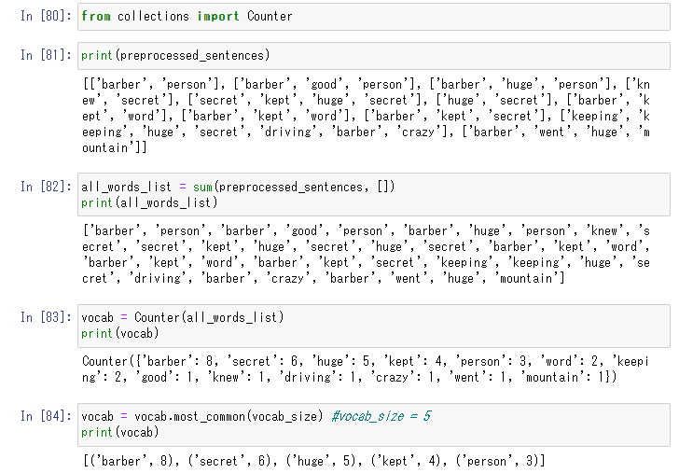
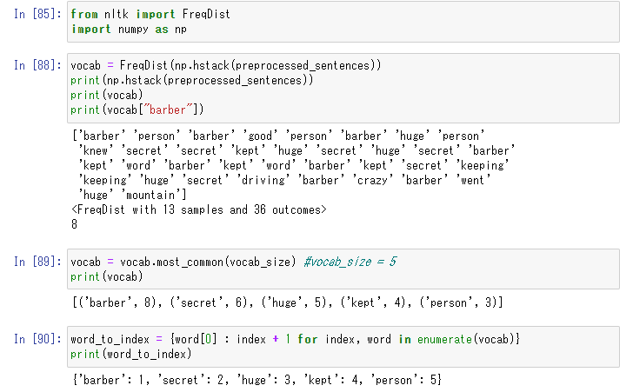

Slide 9
